Slide 1


Questions Bank Generation System
Graduation Project
Academic Year 2023-2024
Midyear Presentation

Slide 2
Team Members
Supervisors
Shenouda Gad Fakhry Gad
Antonious mokhles sedrak
Felotaos waheed zekry basta
Kerolos Basem Tawdrous Louka
Hazem khairy abdelhamid
Ragab Hossny Ahmad hassan
Mohammed Alaa Anter Ahmed
Dr. Ahmed Ezz
Eng. Sara Hamdy

Slide 3

Content
Introduction
Project General Vision
goals
Problem Definition
Solution
Electronic system
System Flowchart
Flowchart Implementation
Examples
Achievement of the First Term
Achievement of the Second Term
Future Work

Slide 4

Introduction
It is an electronic question bank that builds questions programmatically without the need to write the questions manually, which makes it more efficient and accurate without wasting time and effort. It also covers all aspects of the subject through the presence of a large number of different questions that you can get answers to in order to have great knowledge about the subject. Which you are looking for.

Slide 5

The question bank generation system contains different questions that have the same accuracy, experience and revolve around one topic to include the information correctly and you can understand the topic you want to understand without overlapping the information you have.

Slide 6

Project General Vision
This question bank generation system is an integrated system for building and managing online exams.
The general vision of the project is divided into two parts, from the student’s side and from the professor’s side.

Slide 7

Goals
Developing and improving the quality of education.
Evaluate the level of students fairly.
Ease and speed in conducting quizzes and exams while ensuring quality.
Prevent Cheating During Testing.

Slide 8
Goals Cont.:
A Question Bank Generation System(QBGS), is that it is a renewable, programmable and automatic question bank that produces an infinite number of questions with different ideas and different solutions.

Slide 9
Problem Definition

Slide 10

The students:
If you student you need to get a large number of diverse questions that cover all aspects of the topic you are searching for without frequenting many sites that repeat the same questions on different sites, which wastes a lot of your study time.

Slide 11

professors and teachers:
If you are a university doctor or teacher, you want to get a large number of diverse questions that have the same efficiency and different numbers that cover all aspects of the topic, but this will cost you a lot of time and effort.

Slide 12
Solution

Slide 13

The students:
The question bank provides you with the various questions you need to understand your study materials. You practice the different types of questions that can be the subject of an exam without going to many sites that waste a lot of study time.

Slide 14

professors and teachers :
The question bank provides you with the various questions you need in setting different tests that cover all aspects of the subject. These questions have the same idea and different numbers, which helps you set equal tests for all students.

Slide 15
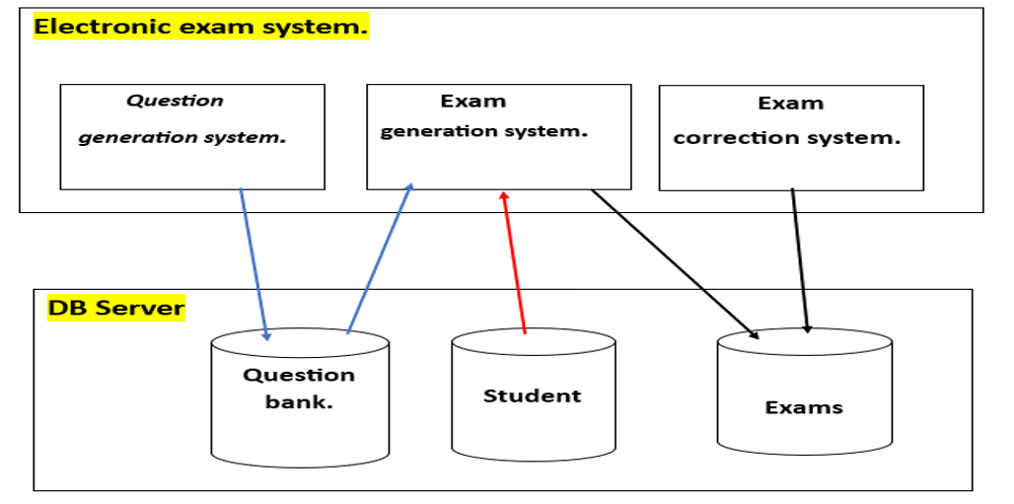
Electronic system.

Slide 16
Electronic exam system:
1-Question generation system:
It is a system that creates questions and stores them in the database within the question bank.
2-Exam generation system:
The exam generation system conducts exams in general, as it takes the set of questions that were created within the database through the question bank.
3-Exam correction system:
It is a system for automatic correction of student exams, as it stores students’ answers and then compares them with the correct exam model stored in the database.

Slide 17
Database server:
1-Questions Bank:
It stores the questions created by the question generation system and then sends them to the exam generation system.
2-Students:
Students solve questions stored within the exam generation system.
3-Exams:
It stores all the exams taken by the students, which the system corrects in the following according to the exam pattern.

Slide 18
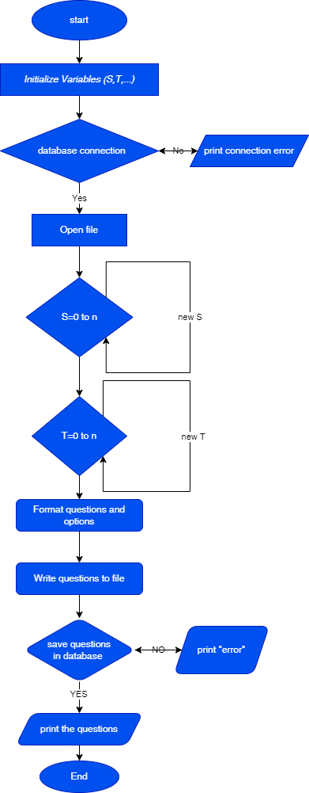
The Flowchart
for Question Bank:

Slide 19
Algorithm for flowchart :
Step 1 : start
Step 2 : Initialize variable (S,T, ...)
Step 3 : database connection
Step 4 : no , go step5
Step 5 : print “connection error”
Step 6 : yes, go step 7
Step 7 : open file
Step 8 : S=(0 to n)
Step 9 : T=(0 to n )
Step 10 : Format questions and operations
Step 11 : Write questions to file
Step 11 : Save questions in database
Step 12 : no, go to step 13
Step 13 : Print “error”
Step 14 : yes, go to step 15
Step 15 : print the questions
Step 16 : End

Slide 20
Pseudocode for Flowchart:
Start the program
Initialize variable (S,T ,....)
Connection database
Open file for writing
Using the for loop to create new variables for (S , T,…)
Format questions and operations
Save questions in database
Print the questions
Finish the program

Slide 21
Examples

Slide 22
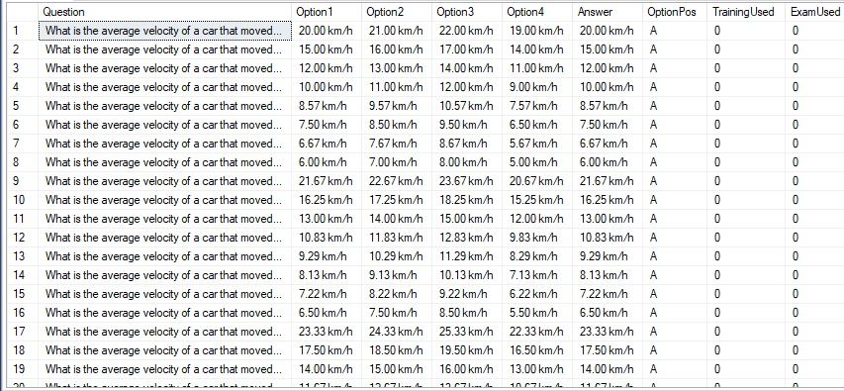
1-Calculates average velocity based on distance and time:

Slide 23
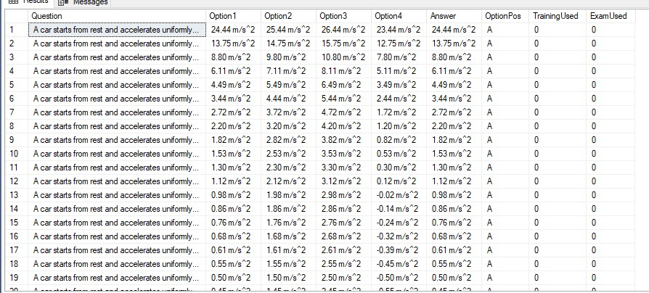
2-Calculates accelerates based on distance and time:

Slide 24
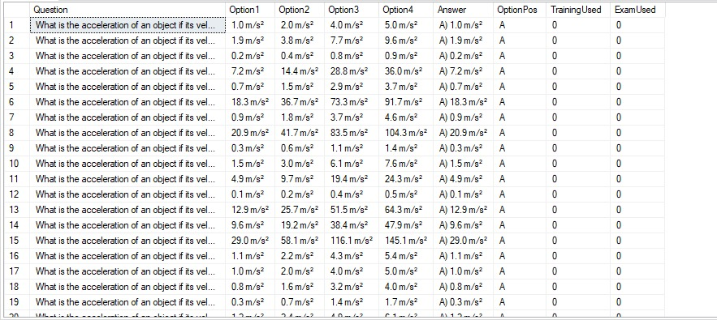
3-Calculates accelerates based on variable velocity and variable time:

Slide 25
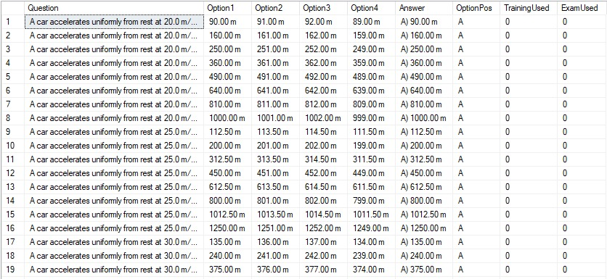
4-Calculates distance based on accelerates and time:

Slide 26
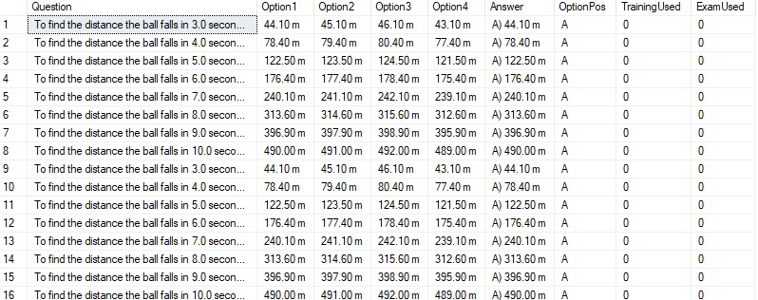
5-Calculates distance based on time and the equation of motion for uniformly accelerated motion :

Slide 27
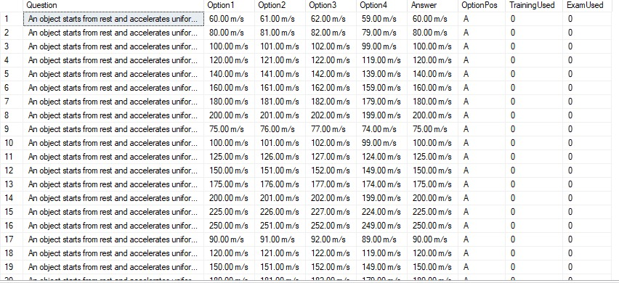
6-Calculates velocity based on accelerates uniformly and time:

Slide 28
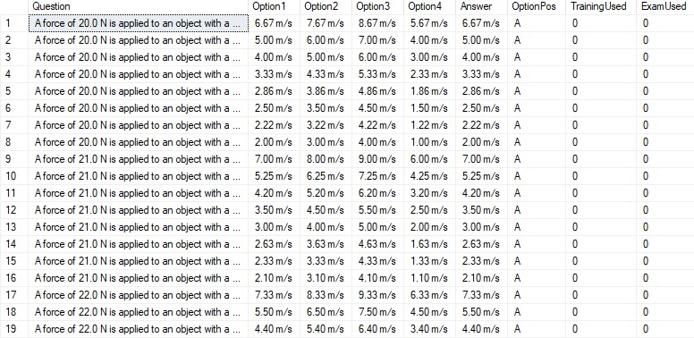
7-Calculates acceleration based on force and mass:

Slide 29
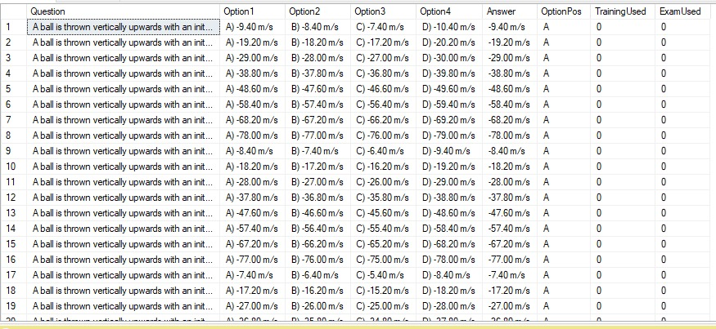
8-Calculates velocity based on initial velocity and time:

Slide 30
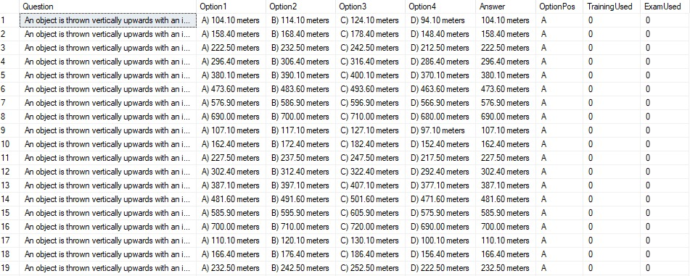
9-Calculates distance based on initial velocity and time:

Slide 31
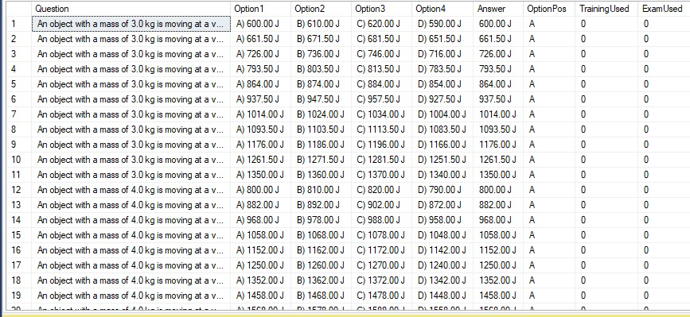
10-Calculates kinetic energy based on mass and velocity:

Slide 32
Achievement of the First Term
Understand the problem.
Building the model.
Understand the question bank generation system requirements.
Choose the material of physics as an example.
Implement some questions and answers.
Save results in text file.

Slide 33
Achievement of the Second Term
Design database for question bank.
Connect the question bank generation system with the Database.
Make wrong answers using random numbers.
Write the final report.
preparing the final presentation.

Slide 34
Future Work
we will develop the question bank to resemble Moodle, and we can also integrate artificial intelligence to enhance its flexibility and user-friendliness, thereby saving time and effort.

Slide 35


